Slide 1





FTNC Automotive
High Quality Lubricants
The Choice of the Professionals

Slide 2
FTNC Automotive
Points for Discussion:
Engine Oil Basics Are all Engine Oils the Same?
Made in England FTNC Ranges
FTNC Engine Lubricants Questions & Open Discussions

Slide 3

FTNC Automotive
Engine Oil Basics

Slide 4
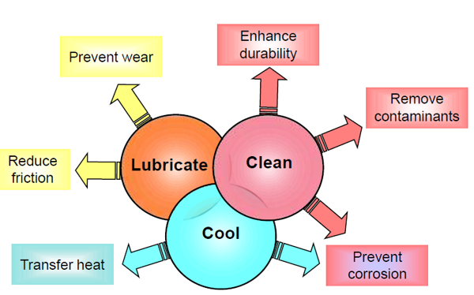
FTNC Automotive
What does an Engine Oil
need to do?

Slide 5
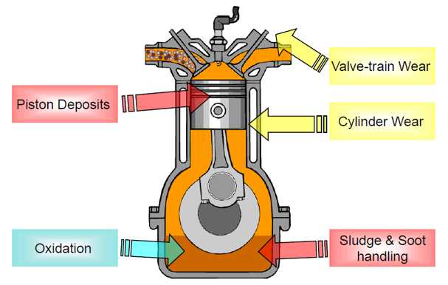
FTNC Automotive
Where does this
phenomena occur?

Slide 6
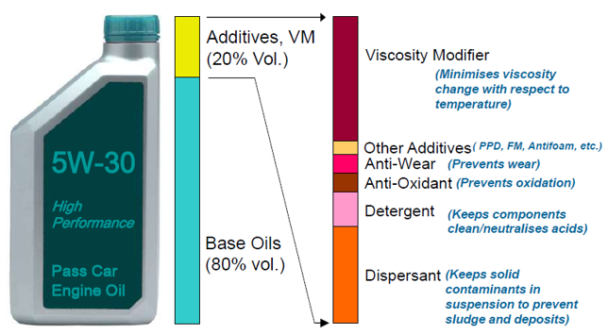
FTNC Automotive
What is in a modern
car engine oil?

Slide 7
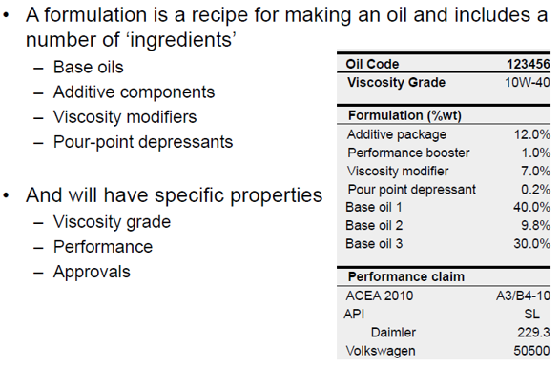
FTNC Automotive
What is an engine oil
formulation?

Slide 8
FTNC Automotive
Are all Engine Oils
the same?

Slide 9
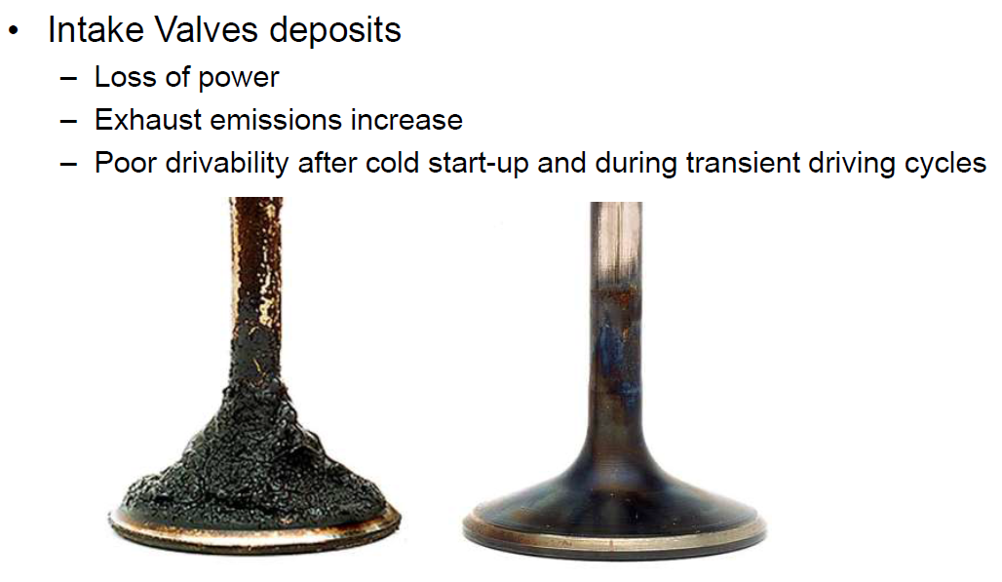
FTNC Automotive
Low Quality Alternatives
=
Potential Problems
Warning - Using low quality lubricants can
have real and dramatic consequences

Slide 10
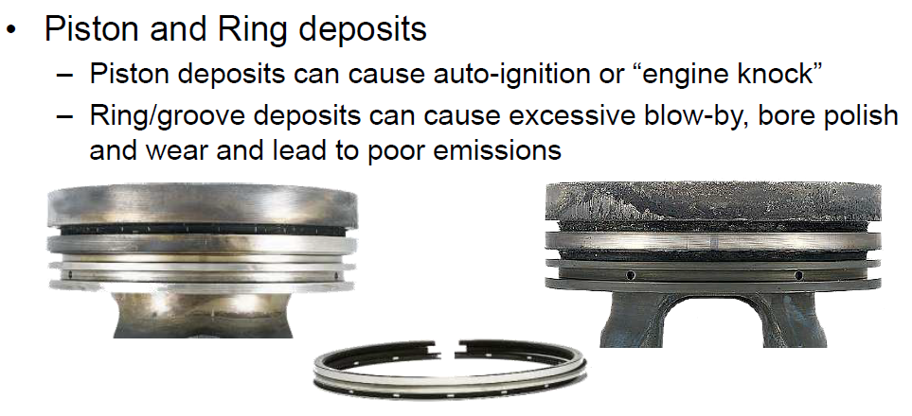
FTNC Automotive
Low Quality Alternatives
=
Potential Problems
Warning - Using low quality lubricants can
have real and dramatic consequences

Slide 11
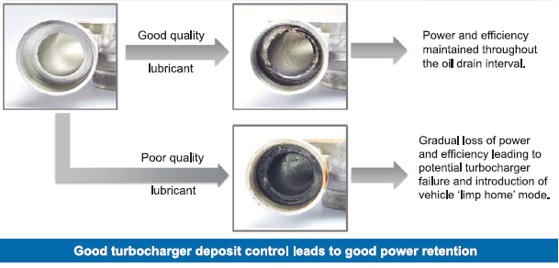
FTNC Automotive
Low Quality Alternatives
=
Potential Problems
Warning - Using low quality lubricants can
have real and dramatic consequences

Slide 12
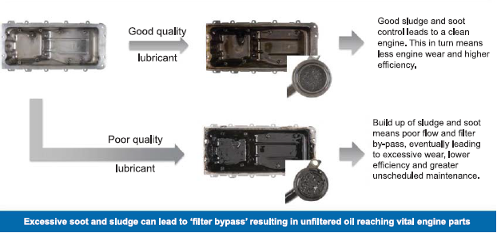
FTNC Automotive
Low Quality Alternatives
=
Potential Problems
Warning - Using low quality lubricants can
have real and dramatic consequences

Slide 13

FTNC Automotive
Made in England
Quality you can trust

Slide 14




FTNC Automotive
All of FTNC’s lubricants are manufactured in England
using recognised base oils and the latest premium additive
systems from the world’s leading additive companies
including Lubrizol, Chevron Oronite and Multisol.

Slide 15

FTNC Automotive
Made in England
Blends formulated and tested within one of our two in house laboratories.
All products are tested before filling
Each product fill has a retained sample held for 2 years.
Every fill is quality controlled & barcoded
Certificates of Analysis given with all deliveries to our export distributors
Technical recommendations given

Slide 16
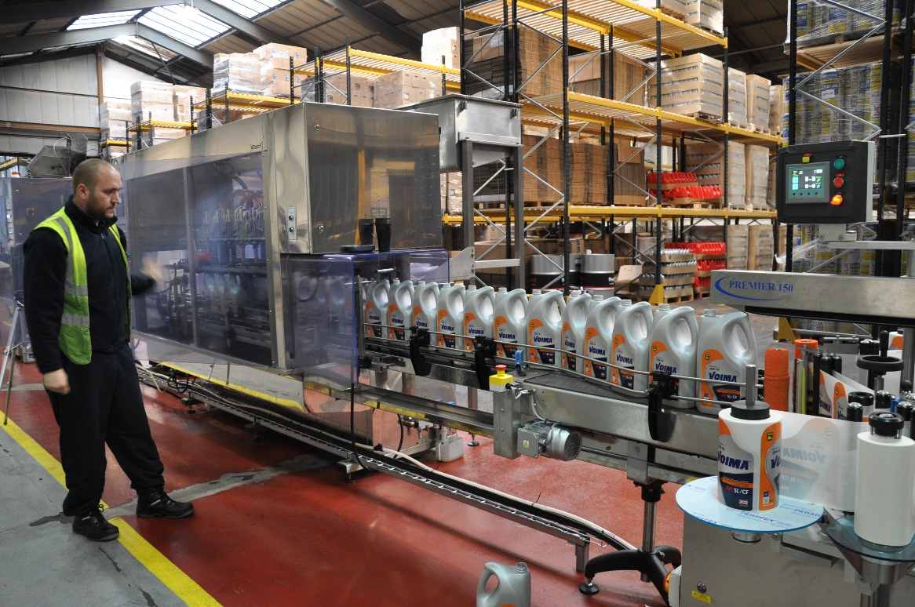
FTNC Automotive
Made in England
Automated machine applies high adhesive labels to the bottles.
All aspects of front the start to the end of the filling are overseen by a trained employee.
Continuity of labelling and bottle quality are inspected to give the perfect finished product.

Slide 17
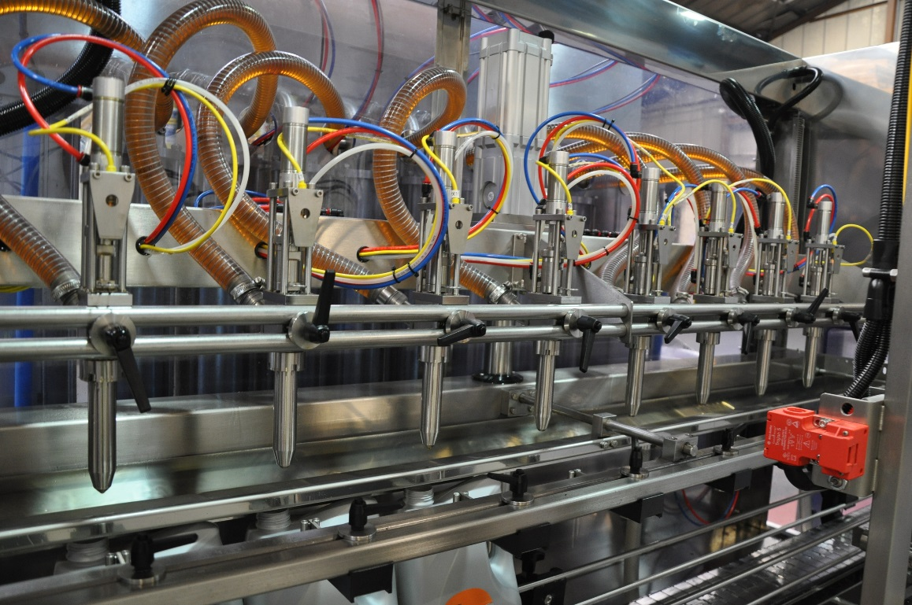
FTNC Automotive
Made in England
All products are filled on a 2016 Masterfil 8 head automated filling machine. This machine ensures the perfect fill every time for both 5 and 1 litre bottles.
The lubricant passes through a mass flowmeter located before the filling nozzle, providing an accurate measure every time.
The specialised nozzles ensure efficient splash-free filling of the lubricant. Giving our customers a perfect looking bottle each and every time.

Slide 18
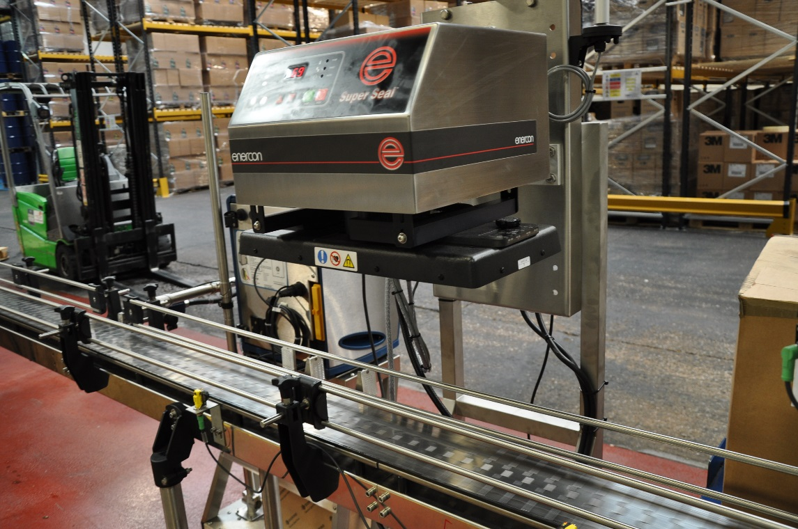
FTNC Automotive
Made in England
Before packing into cartons the bottles and caps are run through a “Super Sealer” to heat seal all the caps preventing leakages and giving our customers a tamper proof bottle and product.

Slide 19
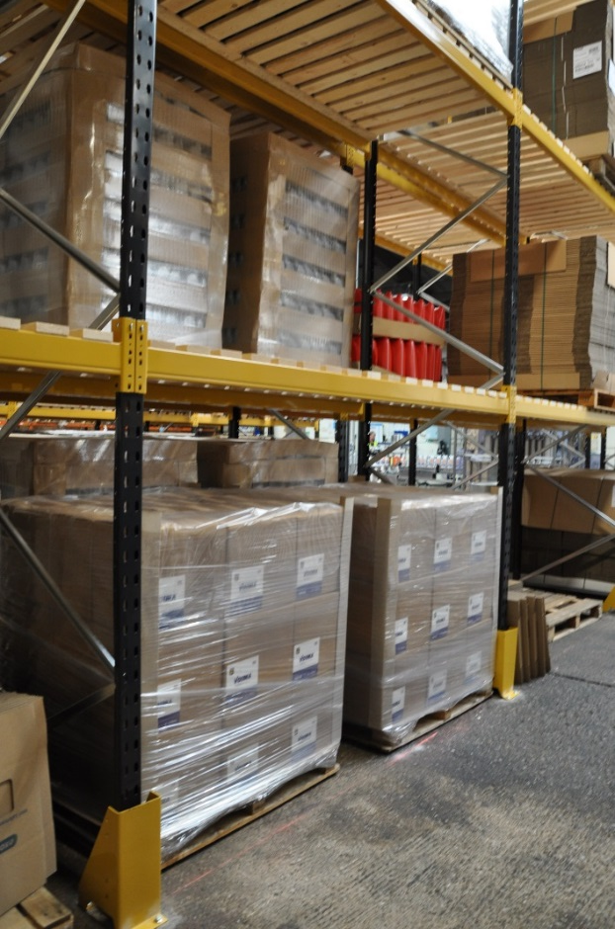
FTNC Automotive
Made in England
The finished product is then packed securely onto new pallets and stored in our purpose built warehouse near Birmingham in England.
All the product is stored inside and wrapped in weather proof shrink wrap until the day of exporting.

Slide 20
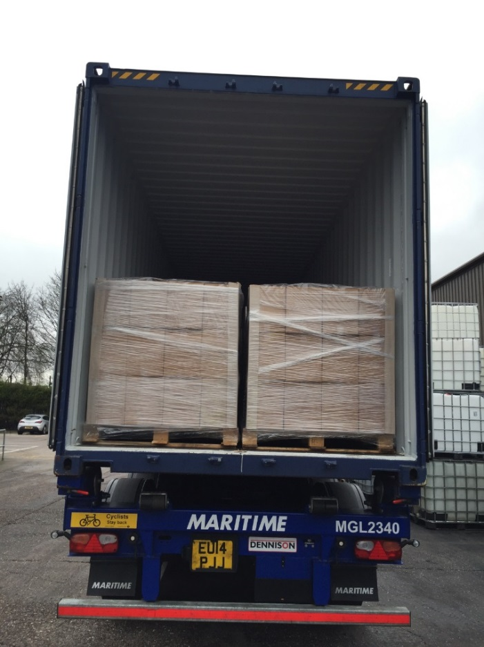
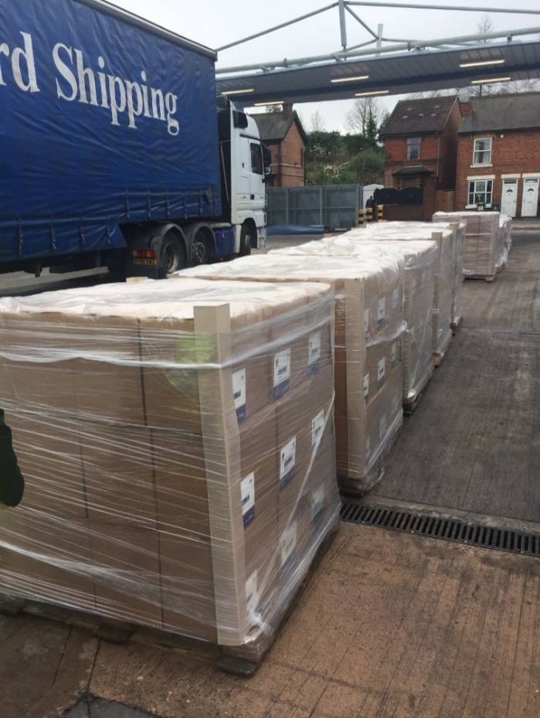
FTNC Automotive
Made in England
The finished product is inspected and signed off to meet the expected high standards of quality, ensuring everything is perfect before loading.
It is then loaded onto containers to be shipped to our customers in Cyprus and other countries.

Slide 21
FTNC Automotive
FTNC Automotive:
Offering lubricants for all business sectors

Slide 22

FTNC Automotive
FTNC Automotive:
Offering lubricants for all business sectors

Slide 23
FTNC Automotive
Key FTNC Engine Oils

Slide 24
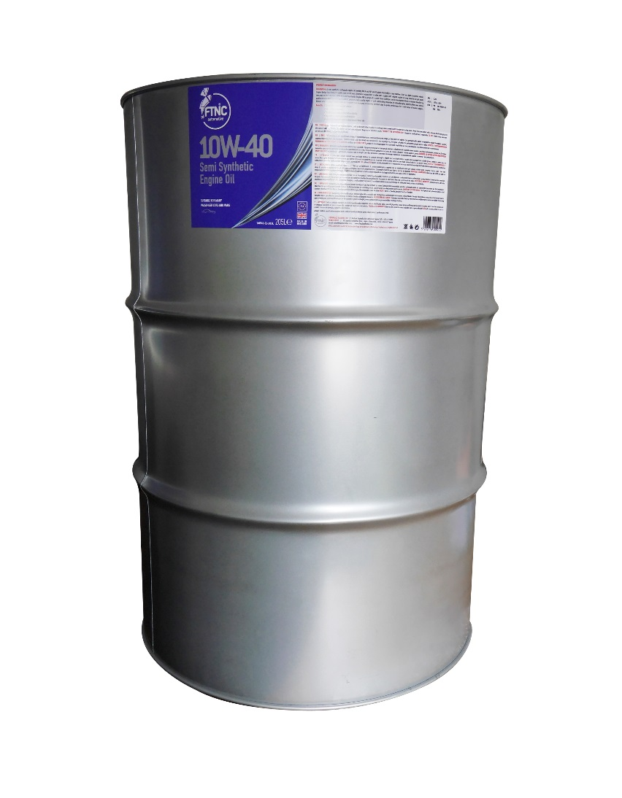
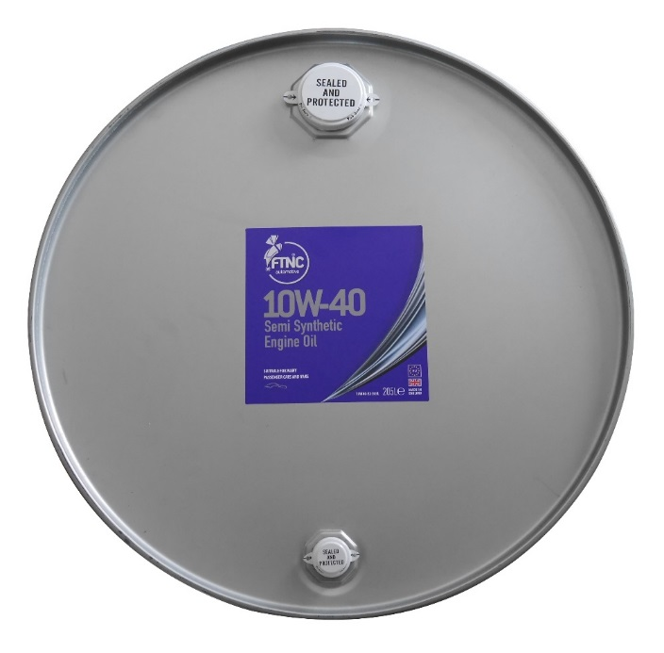
FTNC Automotive
A semi synthetic multigrade engine oil meeting ACEA and API specifications required by a large number of cars and light commercial vehicles. FTNC 10W-40 is designed to meet these challenges and is manufactured from a balanced blend of top quality mineral and synthetic base stocks to produce a high quality engine oil with outstanding properties. Its naturally higher lubricity offers lower internal friction which reduces engine wear and improves fuel economy. It provides excellent stay in grade performance for a wide range of modern engines.
FTNC 10W-40 is suitable for normally aspirated and turbocharged highly stressed diesel and petrol engines in passenger cars and light commercial vehicles. It is miscible with all synthetic and mineral based engine oils.

Slide 25
FTNC Automotive
Benefits:
Suitable for a wide range of vehicles
Stay in grade properties
Excellent high and low temperature stability
Improved oil consumption and emissions
Superior performance over standard mineral based oils
API | SL/CF
ACEA | A3/B3, A3/B4
VW | 502.00/505.00
MB | 229.1

Slide 26
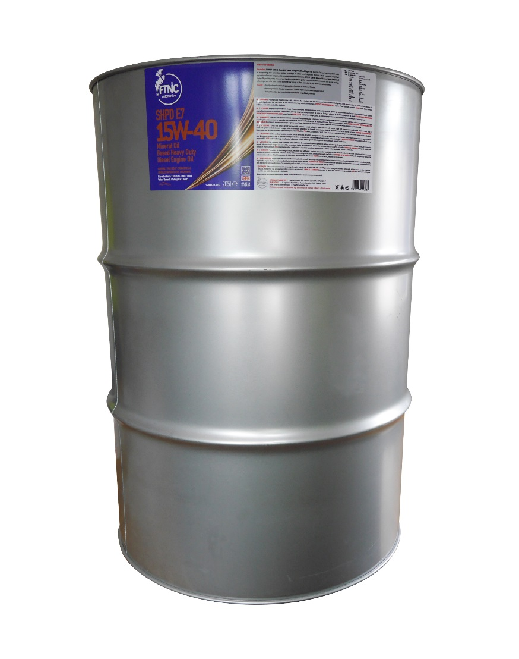
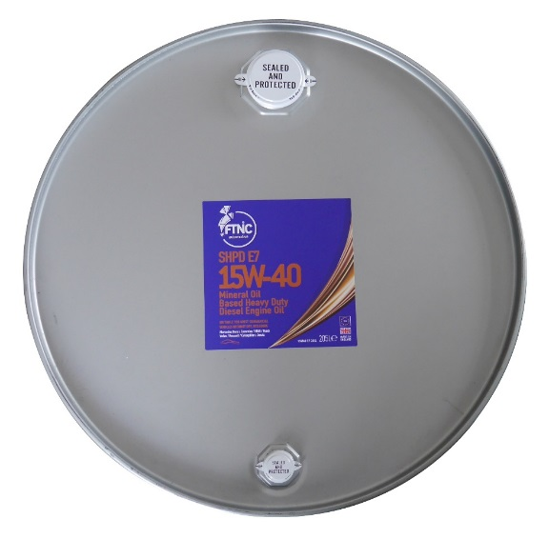
FTNC Automotive
FTNC SHPD E7 15W-40 is a heavy duty diesel engine oil incorporating new generation additive technology. It utilises novel dispersant chemistry which represents a significant upgrade in performance compared with more traditional engine lubricants. FTNC SHPD E7 15W-40 provides greatly enhanced soot handling properties and greater protection to critical components such as main bearings, turbochargers and valve trains. It offers improved flow through oil filters, preventing by-pass and its associated problems.

Slide 27

FTNC Automotive
Greatly enhanced soot handling properties
Contributes to effective oil filtration
Improved protection of engine components
Excellent engine cleanliness and oxidation control
Reduced downtime due to unscheduled maintenance
Long oil drain properties
API | CI-4/SL, CF
ACEA | E7, A3/B3, A3/B4
Mercedes Benz | 228.3, 229.1
Cummins | CES 20078 CES 20071/72/76/77
MAN | M3275
MTU | Type 2
Mack | EO-N / EO-M Plus
Volvo | VDS-3
Renault | RVI RLD-2, RLD
Global | DHD-1
ZF | TE-ML 04C / 07C
Caterpillar | ECF-2, ECF-1-a
Allison | C4
Detroit Diesel | DDC 93K215
JASO | DH-1
Deutz | DQC III-10
Benefits:

Slide 28
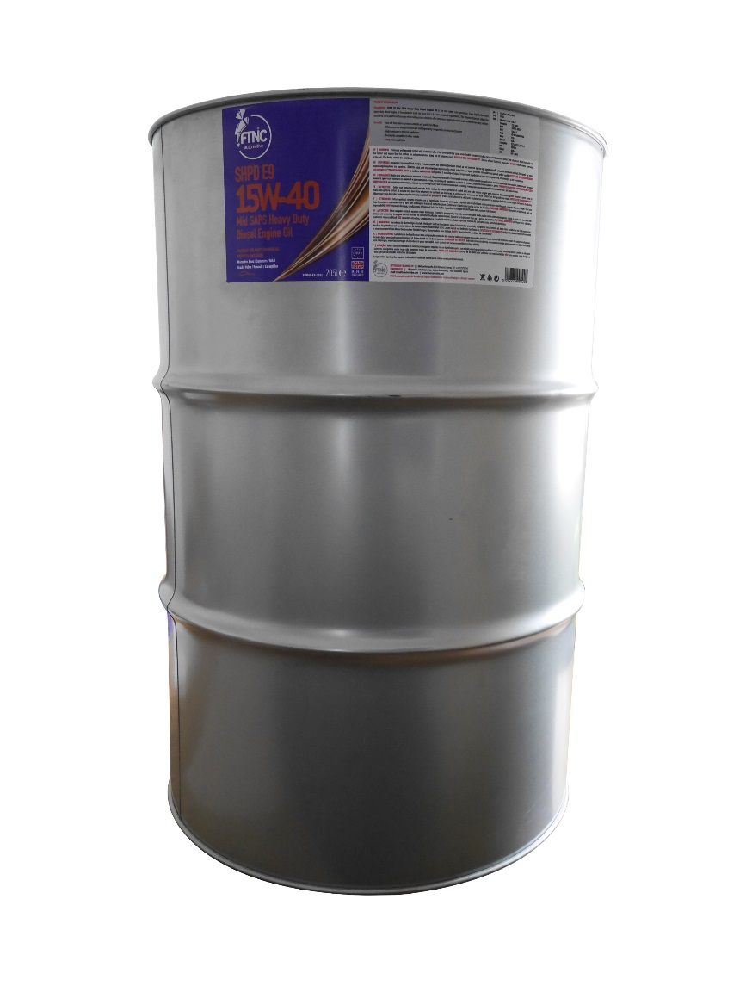
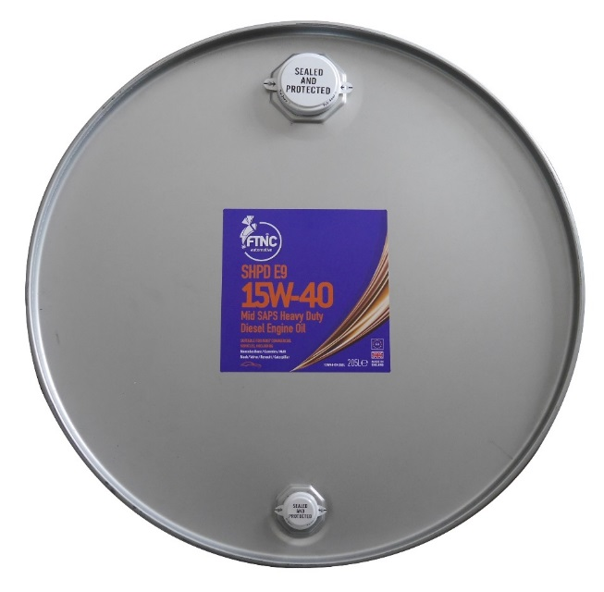
FTNC Automotive
FTNC’s SHPD E9 15W-40 is the very latest, new generation Super High Performance heavy duty diesel engine oil formulated to meet the latest Euro 5 & 6 low emissions requirements. This advanced lubricant utilises the latest mid SAPS additive technology which helps protect sensitive after-treatment systems found in many modern heavy duty vehicles.
SHPD E9 15W-40 has a wide range of applications including original equipment manufacturers (OEMs) such as Volvo, Scania, Renault, Mercedes, DAF and MAN. It is also an ideal choice for many buses, tractors and off-highway applications particularly where the latest low emission engines are used.

Slide 29
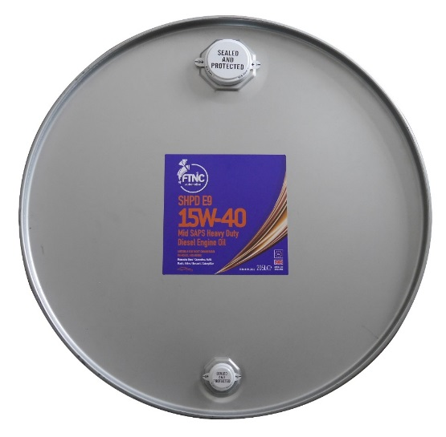
FTNC Automotive
Low ash formulation protects catalysts and particulate filters
Offers improved wear protection and soot dispersancy compared to previous specifications
Highly resistant to thermal breakdown
Backwards compatible to older models
Long drain capabilities
Benefits:
API | CJ-4/CI-4+/CI-4, SM/CF
ACEA | E9, E7
Mercedes Benz | 228.31
Cummins | CES 20081
MAN | M 3575, M 3275
MTU | Type 2.1
Mack | EO-O Premium Plus
Volvo | VDS-4
Renault | RLD-3
Caterpillar | ECF-3, ECF-2, ECF-1-a
DDC | 93K218
Global | DHD-1
JASO | DH-1, DH-2

Slide 30
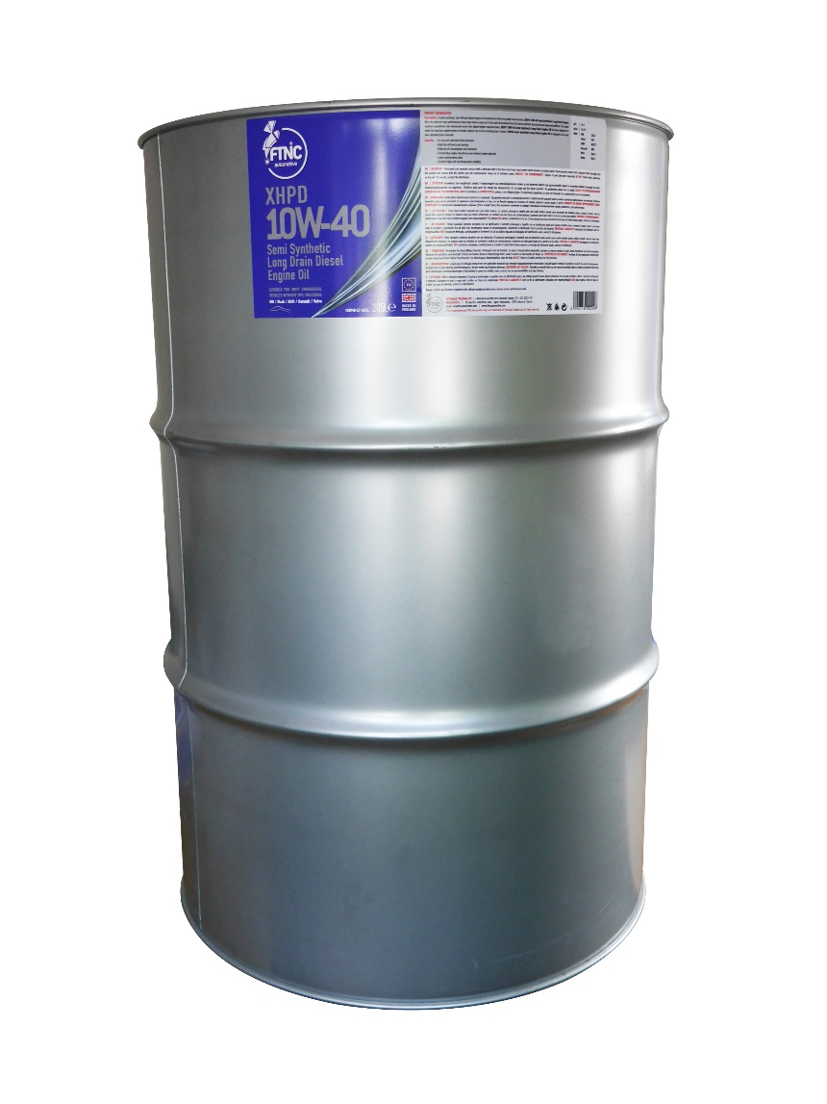
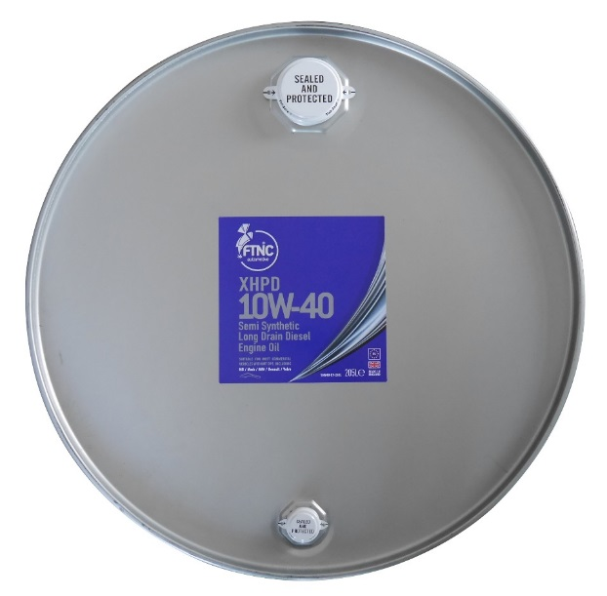
FTNC Automotive
A semi synthetic diesel engine oil meeting long drain requirements. FTNC’s XHPD 10W-40 is a high performance heavy duty diesel engine oil. It has been formulated from the latest synthetic base stocks and approved additives.
Recent emission regulations have demanded more from diesel engine manufacturers. XHPD 10W-40 has been designed to meet the exacting requirements of certain engines up to and including Euro 5.
XHPD 10W-40 is suitable for a wide range of normally aspirated and turbocharged heavy duty diesel engines in trucks, buses, coaches, plant and industrial equipment. It is miscible with all synthetic and mineral based oils.

Slide 31
FTNC Automotive
For use over extended drain intervals
High fuel efficiency and savings
Reduced oil consumption and emissions
Outstanding engine cleanliness and reduced engine deposits
Lower maintenance costs
Excellent high and low temperature stability
Benefits:
ACEA | E4, E7
API | CI-4
MB | 228.5
Mack | EO-L
MAN | M 3277
Renault | RXD
MTU | Type 3
Volvo | VDS-3

Slide 32
FTNC Automotive
We other products available
Please ask.

Slide 33
FTNC Automotive
Thank you for your time.
Do you have any questions?

Slide 34
FTNC Automotive
High Quality Lubricants
Quality You Can Trust!

